Slide 1
Notes:
bitcoin =: ". > 1 {"1 readcsv'/Users/JoshuaEckroth/Documents/git/zigzag/tomoka/bitstampUSDsmall.csv'
(seated) challenge: if I bought $100 of bitcoin at the beginning, how much are they worth now?
btc =: 100 % {. bitcoin
btcNow =: btc * {. |. bitcoin

Slide 2
6:00-6:30
6:30-6:40 break
6:40-7:10
7:10-7:20 break
7:20-7:50
7:50-8:00 break
8:00-8:30
8:30-8:40 break
8:40-9:00

Slide 3

Dec 2016: I discover this computer language called “J,” and I’m motivated by its difficulty and obscurity
Dec-Apr: I study J and develop a way to teach it
Apr 19: J workshop at Stetson for comp. sci. students
Notes:
bitcoin =: ". > 1 {"1 readcsv'/Users/JoshuaEckroth/Documents/git/zigzag/tomoka/bitstampUSDsmall.csv'
(seated) challenge: if I bought $100 of bitcoin at the beginning, how much are they worth now?
btc =: 100 % {. bitcoin
btcNow =: btc * {. |. bitcoin

Slide 4
LEARN To
RECOGNIZE
A GOOD
KNOWLEDGE
TRANCE
Notes:
explain who frank is

Slide 5
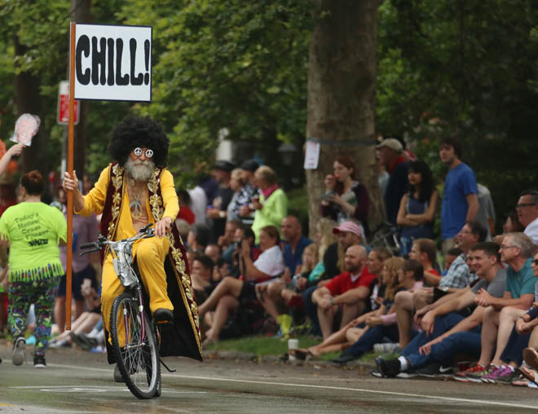
Notes:
Zigzagging through the Straight and Narrow (2009)

Slide 6
BREAK FROM THE BLUB
FIGHT IRONY
PERSEVERE
Notes:
Break from the blub: recognize the value of different approaches; avoid the generalist’s trap
Fight irony: e.g. brainfuck sucks
Persevere: google is useless, docs are very terse; stackoverflow: 1.4 mil javascript tags, 32k haskell, 8k prolog, 243 j

Slide 7
J
a computer language for mathematical computations

Slide 8
J
obscure, terse, powerful,
brilliantly designed...

Slide 9
J
Example: drop lowest x grades from list y, then average the grades
((+/%#)@:((}.@:/:~)^:x)) y
add grades
take last
sort
repeat
count grades
drop lowest
the grades
divide
do left thing
after right thing is done
how many to drop

Slide 10
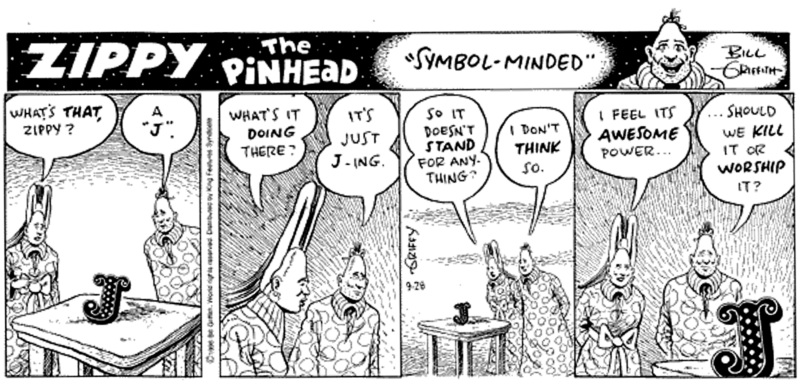

Slide 11
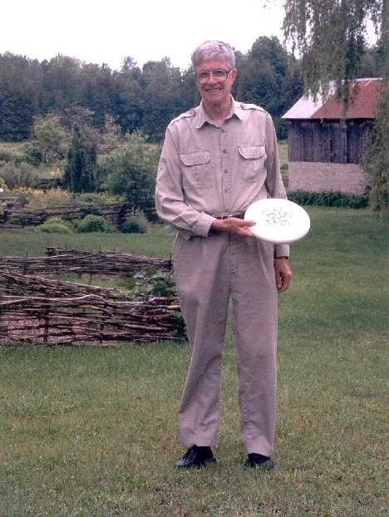
Notes:
“Ken at Kiln Farm with a prototype J Ultimate sportdisc (photo by Jana Michaud)”
http://webbox.lafayette.edu/~reiterc/j/ke_iverson/index.html

Slide 12
J system, v1
typedef char C;typedef long I;
typedef struct a{I t,r,d[3],p[2];}*A;
#define P printf
#define R return
#define V1(f) A f(w)A w;
#define V2(f) A f(a,w)A a,w;
#define DO(n,x) {I i=0,_n=(n);for(;i<_n;++i){x;}}
I *ma(n){R(I*)malloc(n*4);}mv(d,s,n)I *d,*s;{DO(n,d[i]=s[i]);}
tr(r,d)I *d;{I z=1;DO(r,z=z*d[i]);R z;}
A ga(t,r,d)I *d;{A z=(A)ma(5+tr(r,d));z->t=t,z->r=r,mv(z->d,d,r);R z;}
V1(iota){I n=*w->p;A z=ga(0,1,&n);DO(n,z->p[i]=i);R z;}
V2(plus){I r=w->r,*d=w->d,n=tr(r,d);A z=ga(0,r,d);
DO(n,z->p[i]=a->p[i]+w->p[i]);R z;}
V2(from){I r=w->r-1,*d=w->d+1,n=tr(r,d);
A z=ga(w->t,r,d);mv(z->p,w->p+(n**a->p),n);R z;}
V1(box){A z=ga(1,0,0);*z->p=(I)w;R z;}
V2(cat){I an=tr(a->r,a->d),wn=tr(w->r,w->d),n=an+wn;
A z=ga(w->t,1,&n);mv(z->p,a->p,an);mv(z->p+an,w->p,wn);R z;}
V2(find){}
V2(rsh){I r=a->r?*a->d:1,n=tr(r,a->p),wn=tr(w->r,w->d);
A z=ga(w->t,r,a->p);mv(z->p,w->p,wn=n>wn?wn:n);
if(n-=wn)mv(z->p+wn,z->p,n);R z;}
V1(sha){A z=ga(0,1,&w->r);mv(z->p,w->d,w->r);R z;}
V1(id){R w;}V1(size){A z=ga(0,0,0);*z->p=w->r?*w->d:1;R z;}
pi(i){P("%d ",i);}nl(){P("\n");}
pr(w)A w;{I r=w->r,*d=w->d,n=tr(r,d);DO(r,pi(d[i]));nl();
if(w->t)DO(n,P("< ");pr(w->p[i]))else DO(n,pi(w->p[i]));nl();}
C vt[]="+{~<#,";
A(*vd[])()={0,plus,from,find,0,rsh,cat},
(*vm[])()={0,id,size,iota,box,sha,0};
I st[26]; qp(a){R a>='a'&&a<='z';}qv(a){R a<'a';}
A ex(e)I *e;{I a=*e;
if(qp(a)){if(e[1]=='=')R st[a-'a']=ex(e+2);a= st[ a-'a'];}
R qv(a)?(*vm[a])(ex(e+1)):e[1]?(*vd[e[1]])(a,ex(e+2)):(A)a;}
noun(c){A z;if(c<'0'||c>'9')R 0;z=ga(0,0,0);*z->p=c-'0';R z;}
verb(c){I i=0;for(;vt[i];)if(vt[i++]==c)R i;R 0;}
I *wd(s)C *s;{I a,n=strlen(s),*e=ma(n+1);C c;
DO(n,e[i]=(a=noun(c=s[i]))?a:(a=verb(c))?a:c);e[n]=0;R e;}
main(){C s[99];while(gets(s))pr(ex(wd(s)));}
Notes:
One summer weekend in 1989, Arthur Whitney visited Ken Iverson at Kiln Farm and produced—on one page and in one afternoon—an interpreter fragment on the AT&T 3B1 computer. I studied this interpreter for about a week for its organization and programming style; and on Sunday, August 27, 1989, at about four o'clock in the afternoon, wrote the first line of code that became the implementation described in this document.
Arthur's one-page interpreter fragment is as follows.

Slide 14
Leaping head first into the stream of consciousness is good for your balance

Slide 15
Syntax

Slide 16
Statements are exactly one line long
Numbers may be written 2, _2, 0.5
Adjacent numbers make a list: 3 _5 2.333 7
Everything else is a “word”:
Verbs: +, -, %, etc.
Adverbs: ~, /, }, etc.
Others: =., =:, NB., etc.

Slide 17
Evaluation Rules

Slide 18
Forget the table of operator precedence!
J for C Programmers

Slide 19
Right-to-left evaluation:
2*4+5
18
2+4*5
22
(2*4)+5
13
Notes:
No precedence rules except parentheses ()

Slide 20

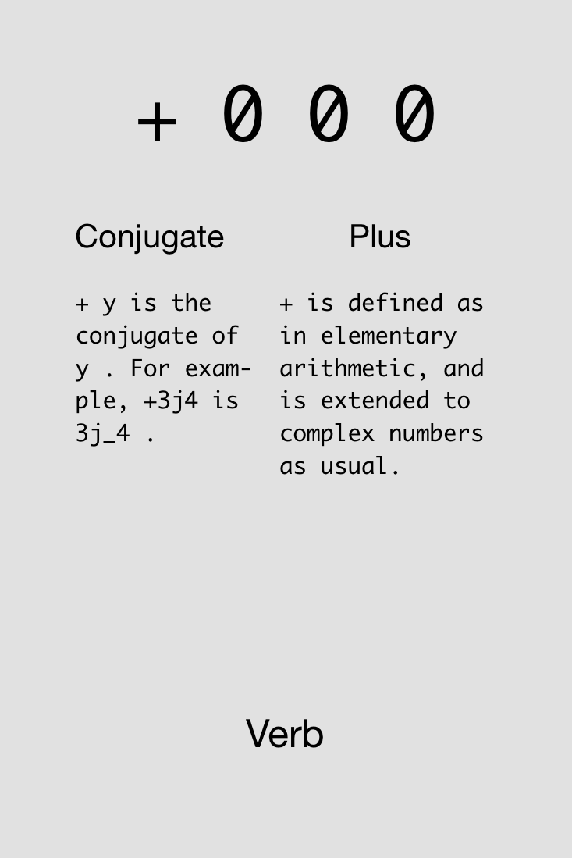
Notes:
Show example in J: 4+5+2

Slide 21

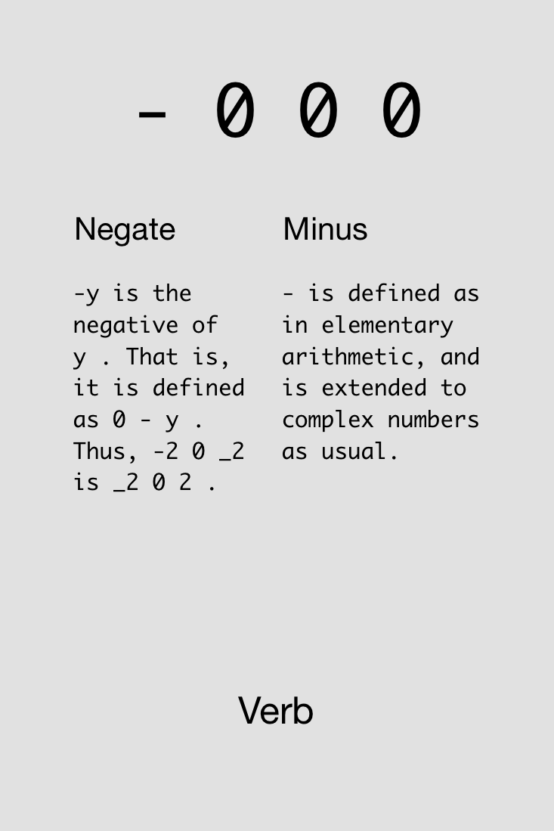

Slide 22





Challenge!
Compute 4-3+2 (which = 3). Try reorderings: 4+2-3, etc.
Find four solutions using all of these cards simultaneously:
4x
4x
4x
4x
4x
2x
2x

Slide 23
Solutions!
Compute 4-3+2 (which = 3).

Slide 24
Solutions!
Compute 4-3+2 (which = 3).

Slide 25

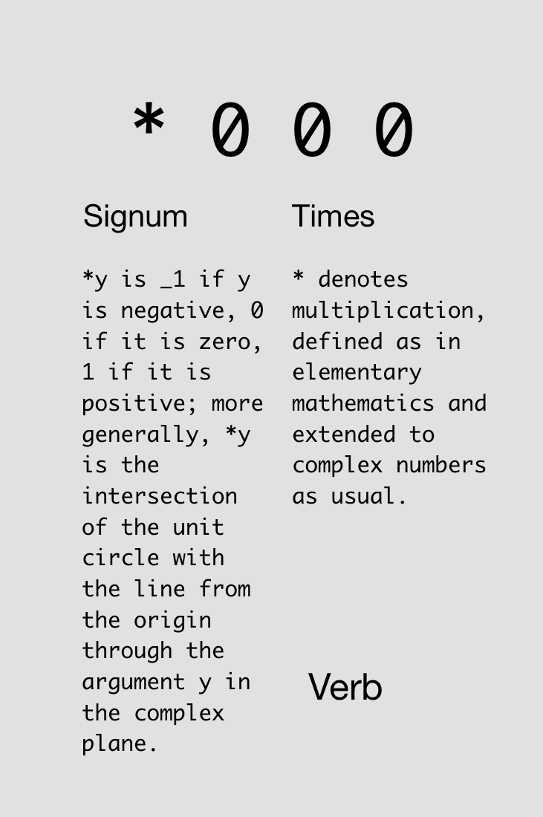

Slide 26

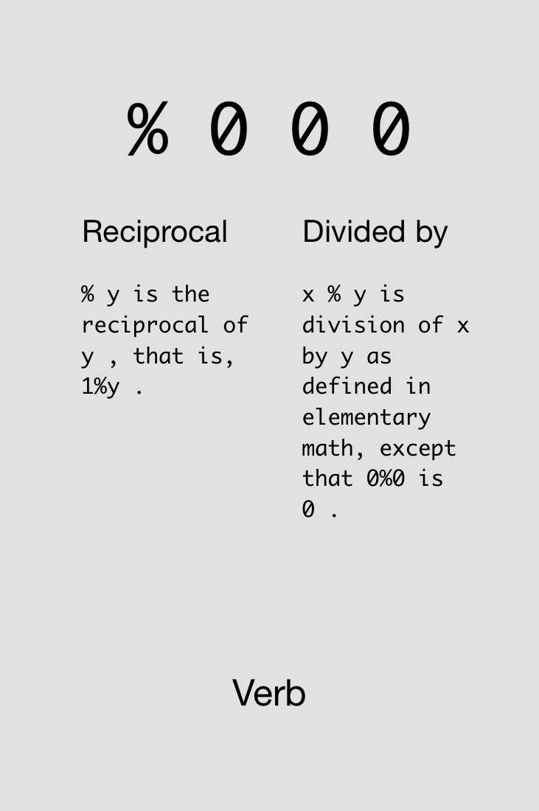

Slide 27
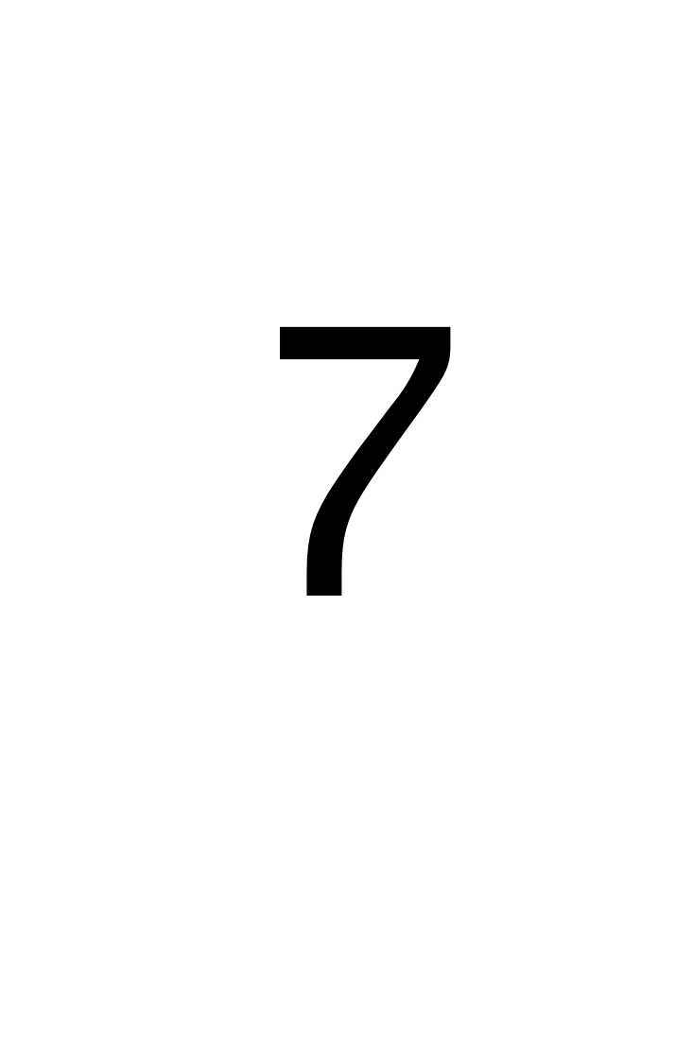
Challenge!
Compute the average of 4 and 7.
Find two solutions using all of these cards simultaneously:
2x
2x
3x
2x
3x
2x
2x

Slide 28
Solutions!
Compute the average of 4 and 7.

Slide 29
Monads & Dyads

Slide 30
y is right arg
x is left arg,
y is right arg

Slide 31
Monad vs. Dyad %:
2%7
0.285714
7%2
3.5
%7
0.142857
%2
0.5

Slide 32
Challenge!
Compute the average of -4 and -7.
Find three solutions using all of these cards simultaneously:
3x
3x
4x
3x
3x
4x
2x
2x

Slide 33
Solutions!
Compute the average of -4 and -7.

Slide 35
Try not to reinvent the rut

Slide 36

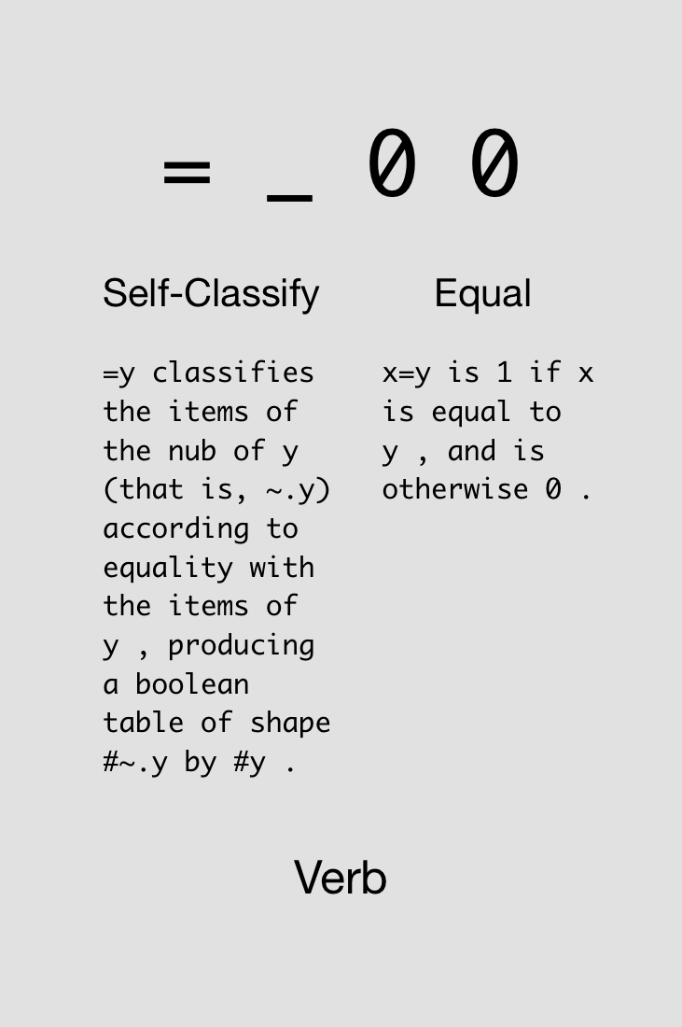

Slide 37

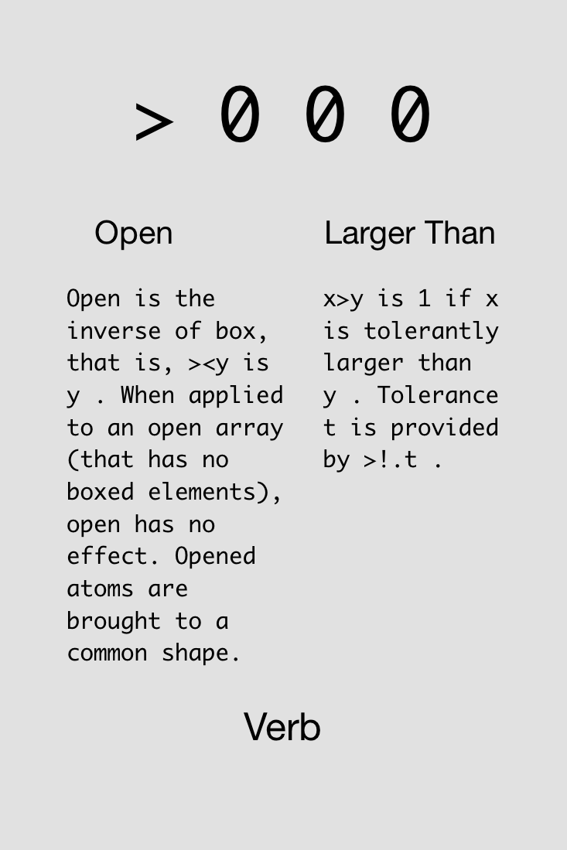

Slide 38
Examples of binary functions.
5 > 4
1
5 < 4
0
0 = 5 > 4
0
5 > 4 = 0
1 (oops, this is really 5>0!)

Slide 40
Multiplication (‘*’) can be used as “AND”.
5 > 4
1
4 > 3
1
(5>4) * (4>3)
1
(5>4) * (3>4)
0

Slide 41

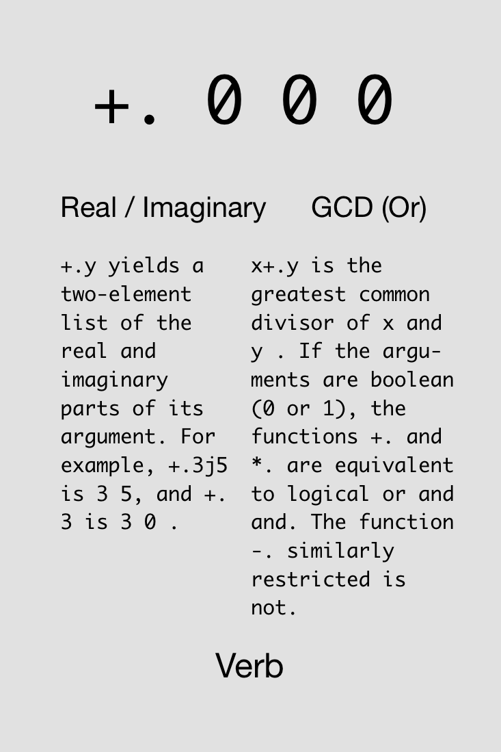

Slide 42



Challenge!
Compute 4 ≤ 5 (which = 1).
Find two solutions using all of these cards simultaneously:
3x
3x
1x
1x
1x
1x
1x
1x

Slide 43
Solutions!
Compute 4 ≤ 5 (which = 1).

Slide 44

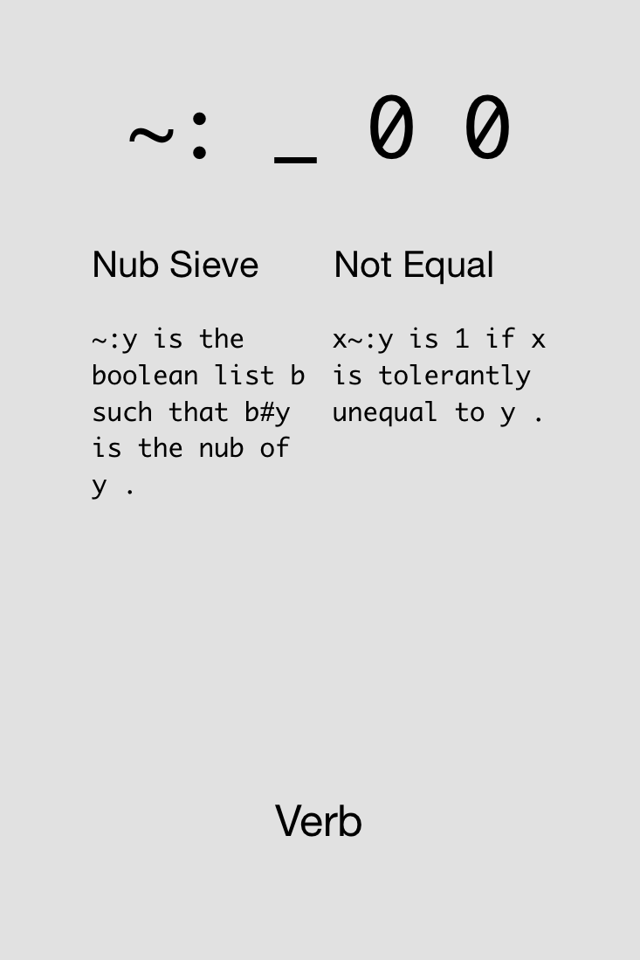

Slide 45

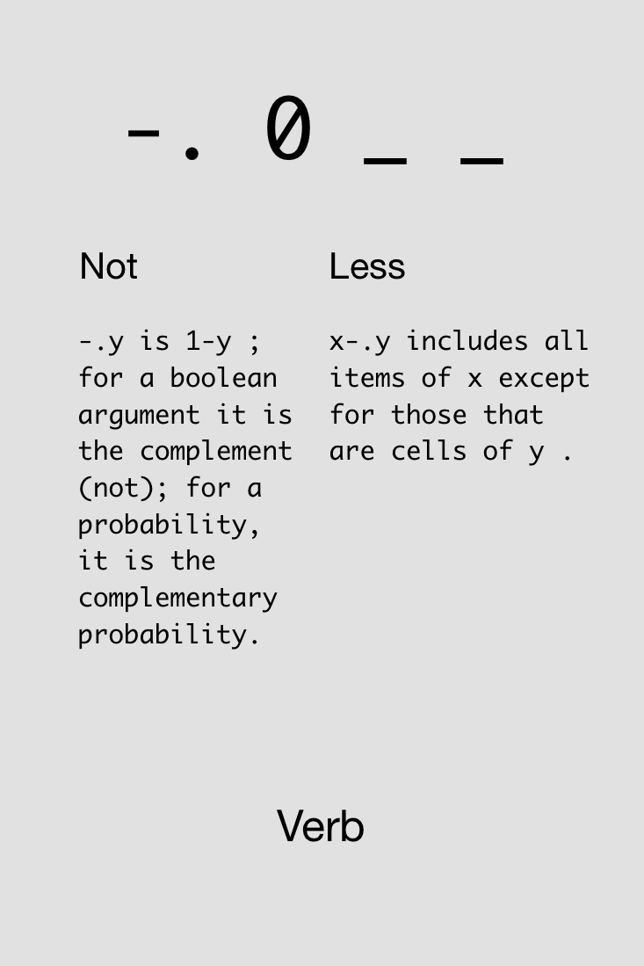

Slide 46

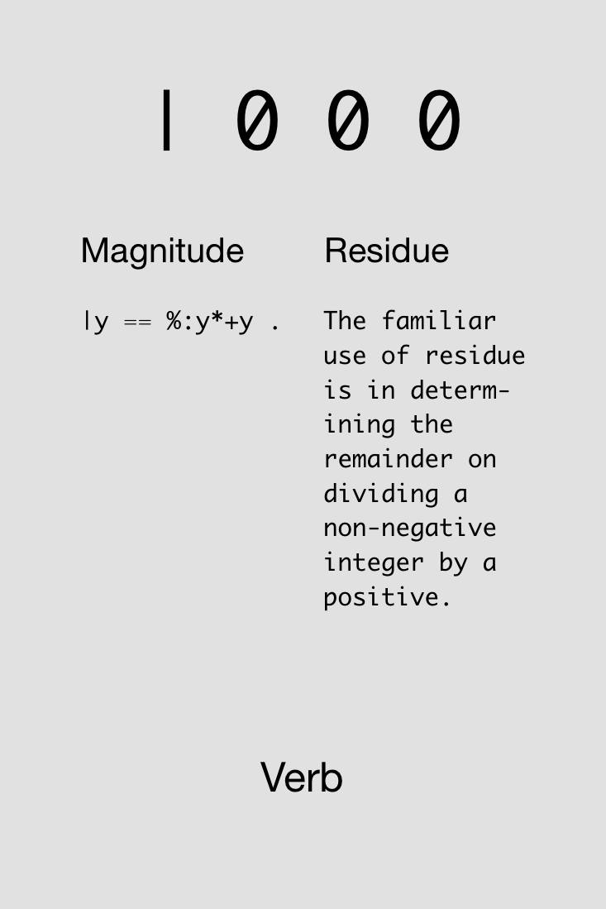

Slide 47
“Residue” gives the remainder after dividing.
2 | 5 NB. e.g., 5/2 = 2 + 1/2
1
2 | 6 NB. e.g., 6/2 = 3 + 0/2
0
3 | 8 NB. e.g., 8/3 = 2 + 2/3
2
4 | 102 NB. e.g., 102/4 = 25 + 2/4
2

Slide 48




Challenge!
Determine if 1996 was a leap year. A leap year is divisible by 4 (i.e., reside is 0), but not divisible by 100.
Find one solution using all of these cards simultaneously:
1x
1x
3x
2x
4x
2x
1x
1x
1x
2x
2x

Slide 49
Solution!
Determine if 1996 was a leap year. A leap year is divisible by 4 (i.e., reside is 0), but not divisible by 100.

Slide 51
Avoid both picking at minutia and sideswiping mountains

Slide 52
Arrays

Slide 53
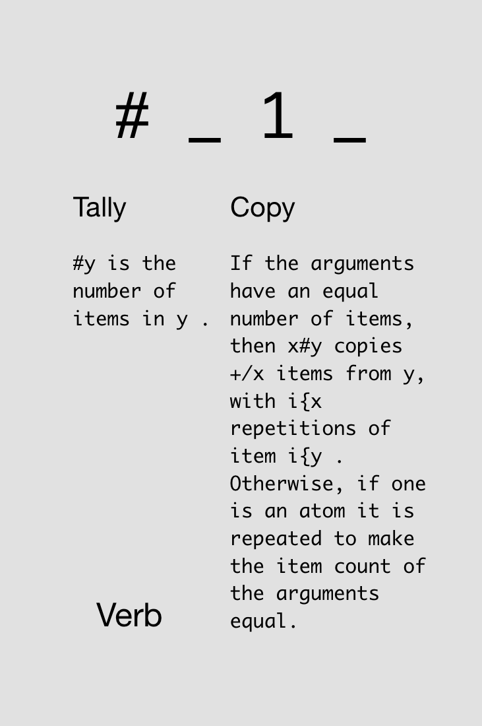

Notes:
Just monadic form

Slide 54
Typing arrays and asking their size:
5 3 7 9
5 3 7 9
# 5 3 7 9
4
# 7
1
# # 1 2 3
1

Slide 55
Notes:
Now dyadic form

Slide 56
Using dyadic “#” for copying:
3 # 10
10 10 10
2 # 5
5 5
0 # 7
_2 # 7
|domain error

Slide 57
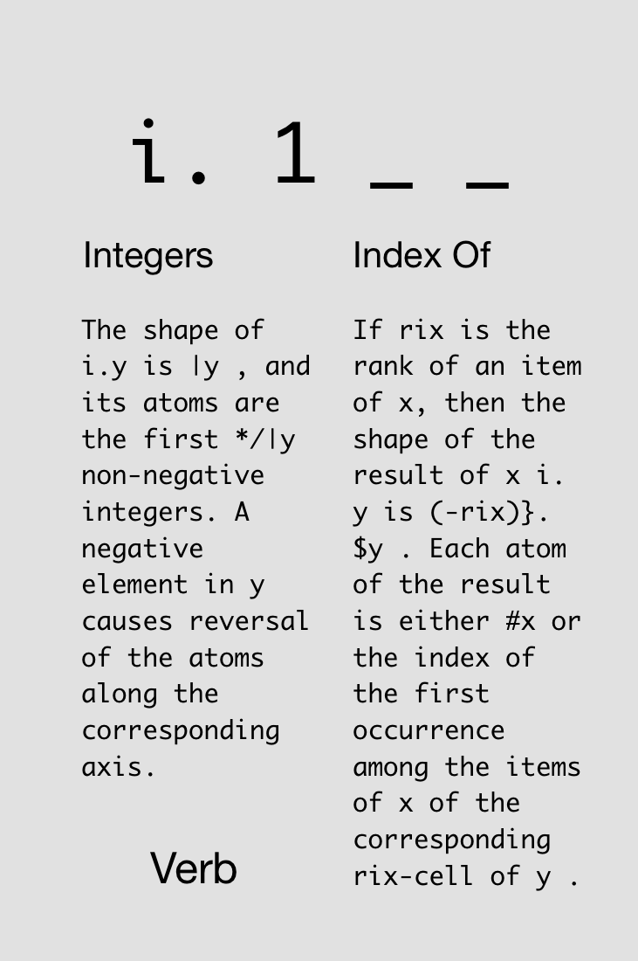


Slide 58
i.4
0 1 2 3
3+i.4
3 4 5 6
3#i.4
0 0 0 1 1 1 2 2 2 3 3 3
#3#i.4
12
3##i.4
4 4 4

Slide 59
In J, every operator has a loop built in.
J for C Programmers

Slide 60
Automatic element-by-element operations:
1 2 3 + 4 5 6
5 7 9
1 + 4 5 6
5 6 7
1 2 + 4 5 6
|length error
| 1 2 +4 5 6

Slide 61
Automatic element-by-element operations:
3 # 4 5 6
4 4 4 5 5 5 6 6 6
1 2 3 # 4 5 6
4 5 5 6 6 6
1 2 3 # 4
4 4 4 4 4 4
1 2 # 4 5 6
|length error
| 1 2 #4 5 6

Slide 62
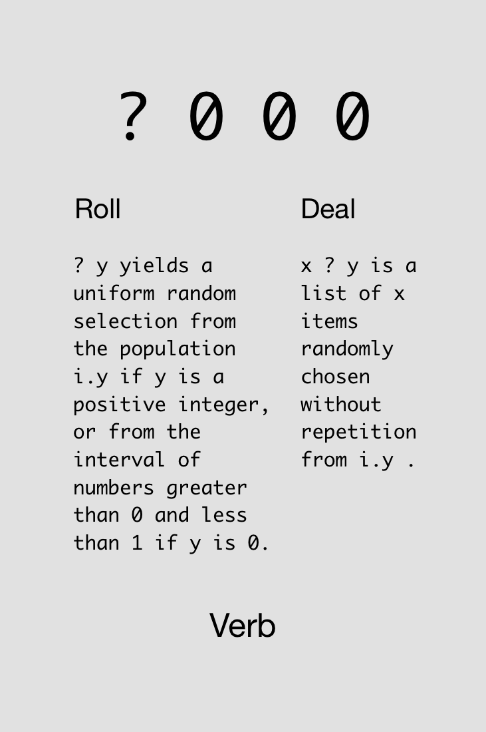



Slide 63
Rolling a die:
? 6
5
? 6
3
? 6 (oops, 0 is not valid)
0
1 + ? 6 NB. 1+ to get nums 1-6
6

Slide 64
Rolling multiple dice:
? 6 6 6
3 0 2
1 + ? 6 6 6 6 6
2 2 3 1 2

Slide 65

Challenge!
Roll 5 dice.
Find two solutions using all of these cards simultaneously:
1x
2x
2x
2x
2x
1x
1x

Slide 66
Solutions!
Roll 5 dice.

Slide 67
Adverbs
Notes:
Loopless coding

Slide 68
A noun holds data; a verb operates on one or two nouns to produce a result which is a noun; an adverb operates on one noun or verb to produce a derived entity.
J for C Programmers

Slide 69

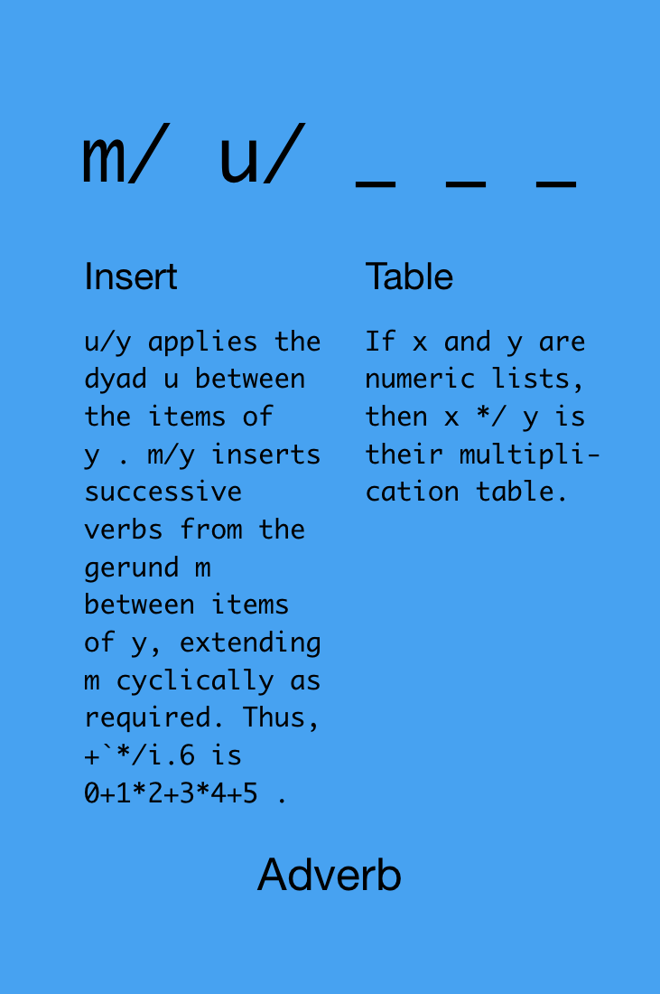

Slide 70
1+2+3+4+5
15
+/1 2 3 4 5
15
*/1 2 3 4 5
120
+/i.10 NB. i.e., 0+1+2+...+9
45

Slide 71
+/?5#6 NB. add 5 dice rolls
16
+/?5#6 NB. do it again, new rolls
9
NB. find average of array 3 5 11
(+/ 3 5 11) % (# 3 5 11)
6.33333

Slide 72
Challenge!
Determine if any of 5 dice rolls was a 6 (=1 if yes, =0 if no).
Find two solutions using all of these cards simultaneously:
2x
4x
2x
2x
2x
2x
1x
1x
1x
2x

Slide 73
Solutions!
Determine if any of 5 dice rolls was a 6 (=1 if yes, =0 if no).

Slide 75
Never put a seat belt around your intuition

Slide 76
Definitions

Slide 77
We can save data into a “variable”:
temps =: 86 85 83 87
Now we can use the variable in computations:
# temps
4
+/ temps
341

Slide 78
We can also define new verbs.
avg =: monad define
(+/ y) % (# y)
)
Now we can use the verb in computations:
avg temps
85.25

Slide 79
When defining monads, we can refer to “y”. When defining dyads, we can refer to “x” and “y.”
rollDice =: dyad define
>:?x#y
)
Now we can use the verb in computations:
5 rollDice 6
2 2 6 5 3
3 rollDice 20
8 12 11

Slide 80
We can load data files and save the data into a variable for further computations.
(Demo)
Notes:
load 'csv’
delandTemps =: ". > 4 {"1 readcsv'/Users/JoshuaEckroth/Documents/git/zigzag/tomoka/deland-temps.csv’
delandTemps
# delandTemps
avg delandTemps

Slide 81
More Verbs

Slide 82

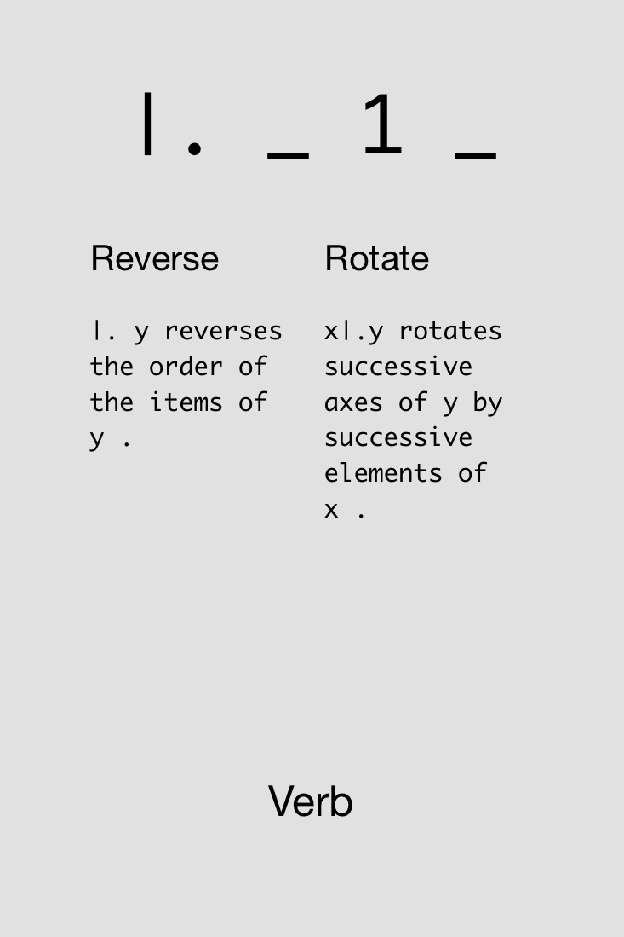

Slide 83

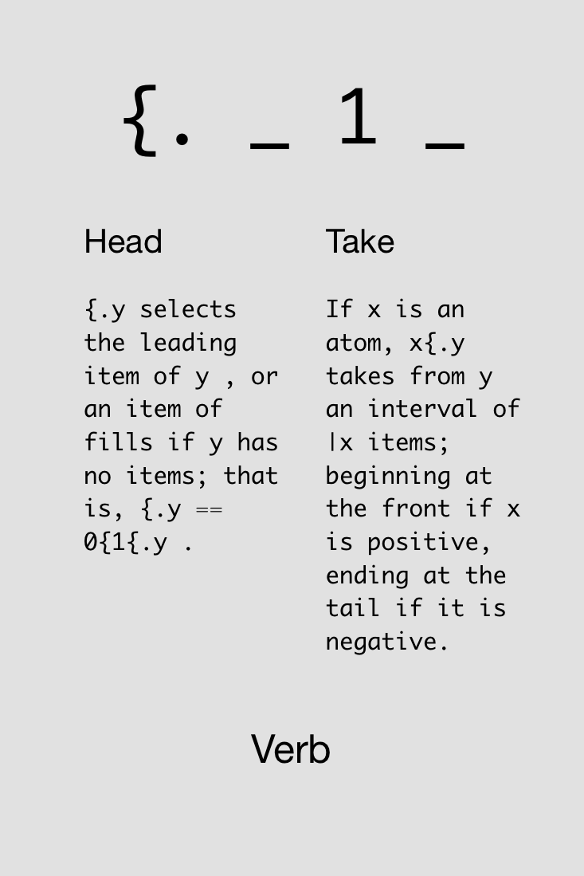

Slide 84
(Demo)
Notes:
load 'csv’
delandTemps =: ". > 4 {"1 readcsv'/Users/JoshuaEckroth/Documents/git/zigzag/tomoka/deland-temps.csv’
delandTemps
# delandTemps
avg delandTemps

Slide 85
More Adverbs

Slide 86

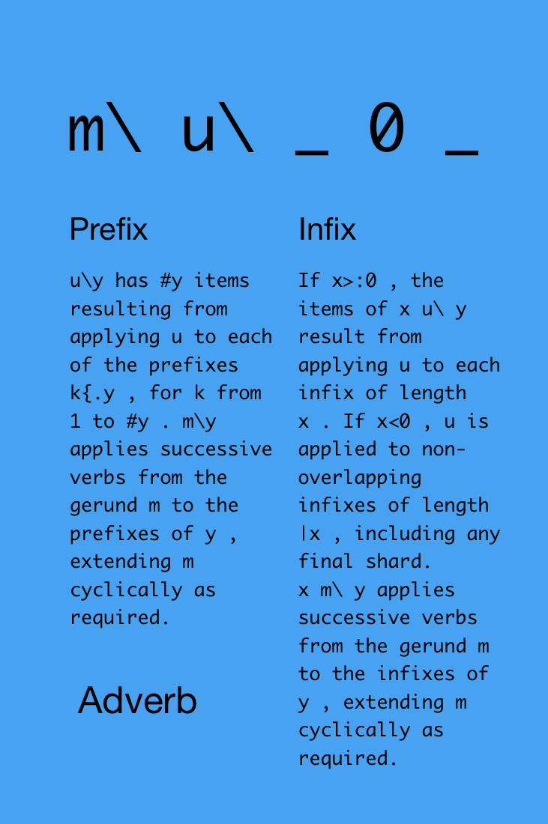

Slide 87
Monadic form:
#\ 3 2 7 1
1 2 3 4
NB. that was the same as:
(# 3), (# 3 2), (# 3 2 7), (# 3 2 7 1)
1 2 3 4

Slide 88
Monadic form:
+/\ 3 2 7 1
3 5 12 13
NB. that was the same as:
(+/ 3), (+/ 3 2), (+/ 3 2 7), (+/ 3 2 7 1)
3 5 12 13

Slide 89
Dyadic form:
2 #\ 3 2 7 1
2 2 2
NB. that was the same as:
(# 3 2), (# 2 7), (# 7 1)
2 2 2

Slide 90
Dyadic form:
2 +/\ 3 2 7 1
5 9 8
NB. that was the same as:
(+/ 3 2), (+/ 2 7), (+/ 7 1)
5 9 8

Slide 91
Dyadic form, negative left side means “non-overlapping”:
_2 +/\ 3 2 7 1
5 8
NB. that was the same as:
(+/ 3 2), (+/ 7 1)
5 8

Slide 92
(Demo)
Notes:
compute averages over (nearly) each week:
btcWeekly =: (-(6*24*7)) avg\ bitcoin

Slide 93

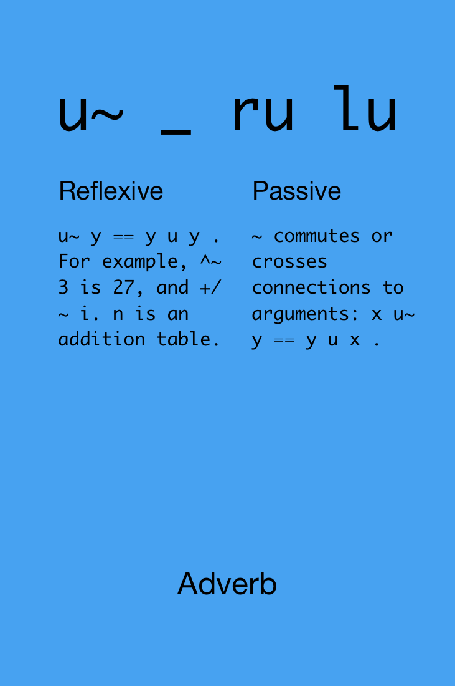

Slide 94
5 - 2
3
5 -~ 2
_3
2 -/\ 10 7 8 4
3 _1 4
2 -~/\ 10 7 8 4
_3 1 _4

Slide 95
(Demo)
Notes:
biggest week drop?
btcWeeklyChanges =: 2 -~/\ btcWeekly
<./ btcWeeklyChanges
and biggest week gain?
>./ btcWeeklyChanges

Slide 97
Sliding your brain into neutral
engages your spiritual transmission

Slide 98
Visualization

Slide 99
(Demo)

Slide 100


Slide 101
STAY
IN THE
PLEASANT
TENSE

